Slide 1

ECOMMERCE PRESENTATION
TEAM ECOMMERCE 2012

Slide 2
WHAT IS ECOMMERCE ?
Electronic commerce, commonly known as e-commerce or e-comm, is the buying and selling of products or services over electronic systems such as the Internet and other computer networks. Electronic commerce draws on such technologies as electronic funds transfer, supply chain management, Internet marketing, online transaction processing, electronic data interchange(EDI), inventory management systems, and automated data collection systems. Modern electronic commerce typically uses the World Wide Web at least at one point in the transaction's life-cycle, although it may encompass a wider range of technologies such as e-mail, mobile devices and telephones as well.

Slide 3
WHAT IS ECOMMERCE ?
E-commerce can be divided into:
E-tailing or "virtual storefronts" on Web sites with online catalogs, sometimes gathered into a "virtual mall"
The gathering and use of demographic data through Web contacts
Electronic Data Interchange (EDI), the business-to-business exchange of data
E-mail and fax and their use as media for reaching prospects and established customers (for example, with newsletters)
Business-to-business buying and selling
The security of business transactions

Slide 5
WHAT WE DO
SOCIAL MEDIA | PKS DEALING | PAYMENT REFINANCING | SERVER | SYSTEM DEV.
SOCIAL MEDIA DAILY | JNE | JATIS | SERVER MANTAINANCE | SYSTEM SECURITIES
SOCIAL MEDIA EVENT | BCA CC | KREDITPLUS | SERVER SECURITIES | SYSTEM DEVELOPMENT
SOCIAL MEDIA STRATEGY | SSL |  | SERVER TWEAKING | PAYMENT GATEWAY INTEGRATION
SOCIAL MEDIA PROMOTION |  |  | SERVER MONITORING | LAYOUT OPTIMIZING
- REAL STORE |  |  |  | SEO
- WEBSTORE |  |  |  | SMO
SOCIAL MEDIA SUPPORT |  |  |  | SYSTEM MONITORING
- REAL STORE |  |  |  | SSL INTEGRATION
- WEBSTORE |  |  |  | PAYMENT SECURITIES
OUT LINKING |  |  |  | BANNER MANAGEMENT
USER COMPLAIN |  |  |  | STORE LOCATOR MANAGEMENT

Slide 6
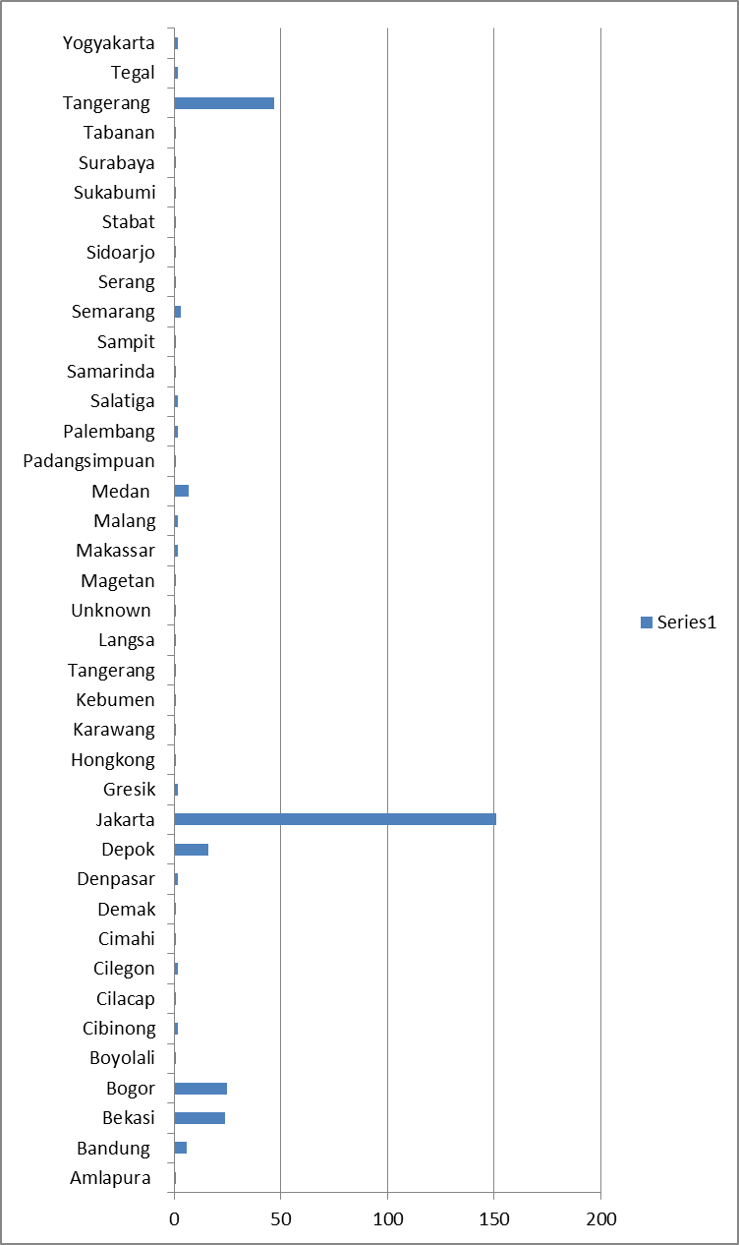
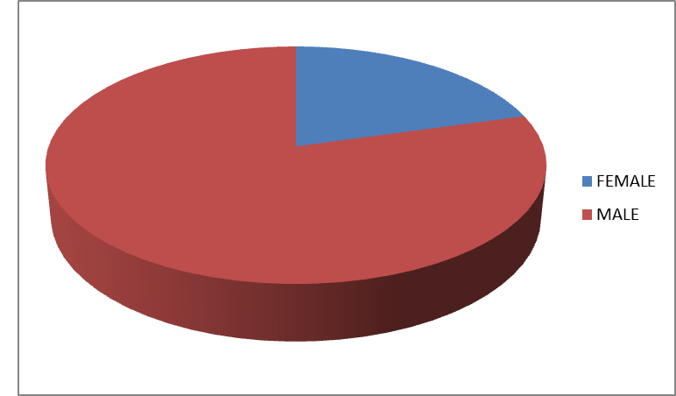
MEMBERS
TOTAL : 560

Slide 7
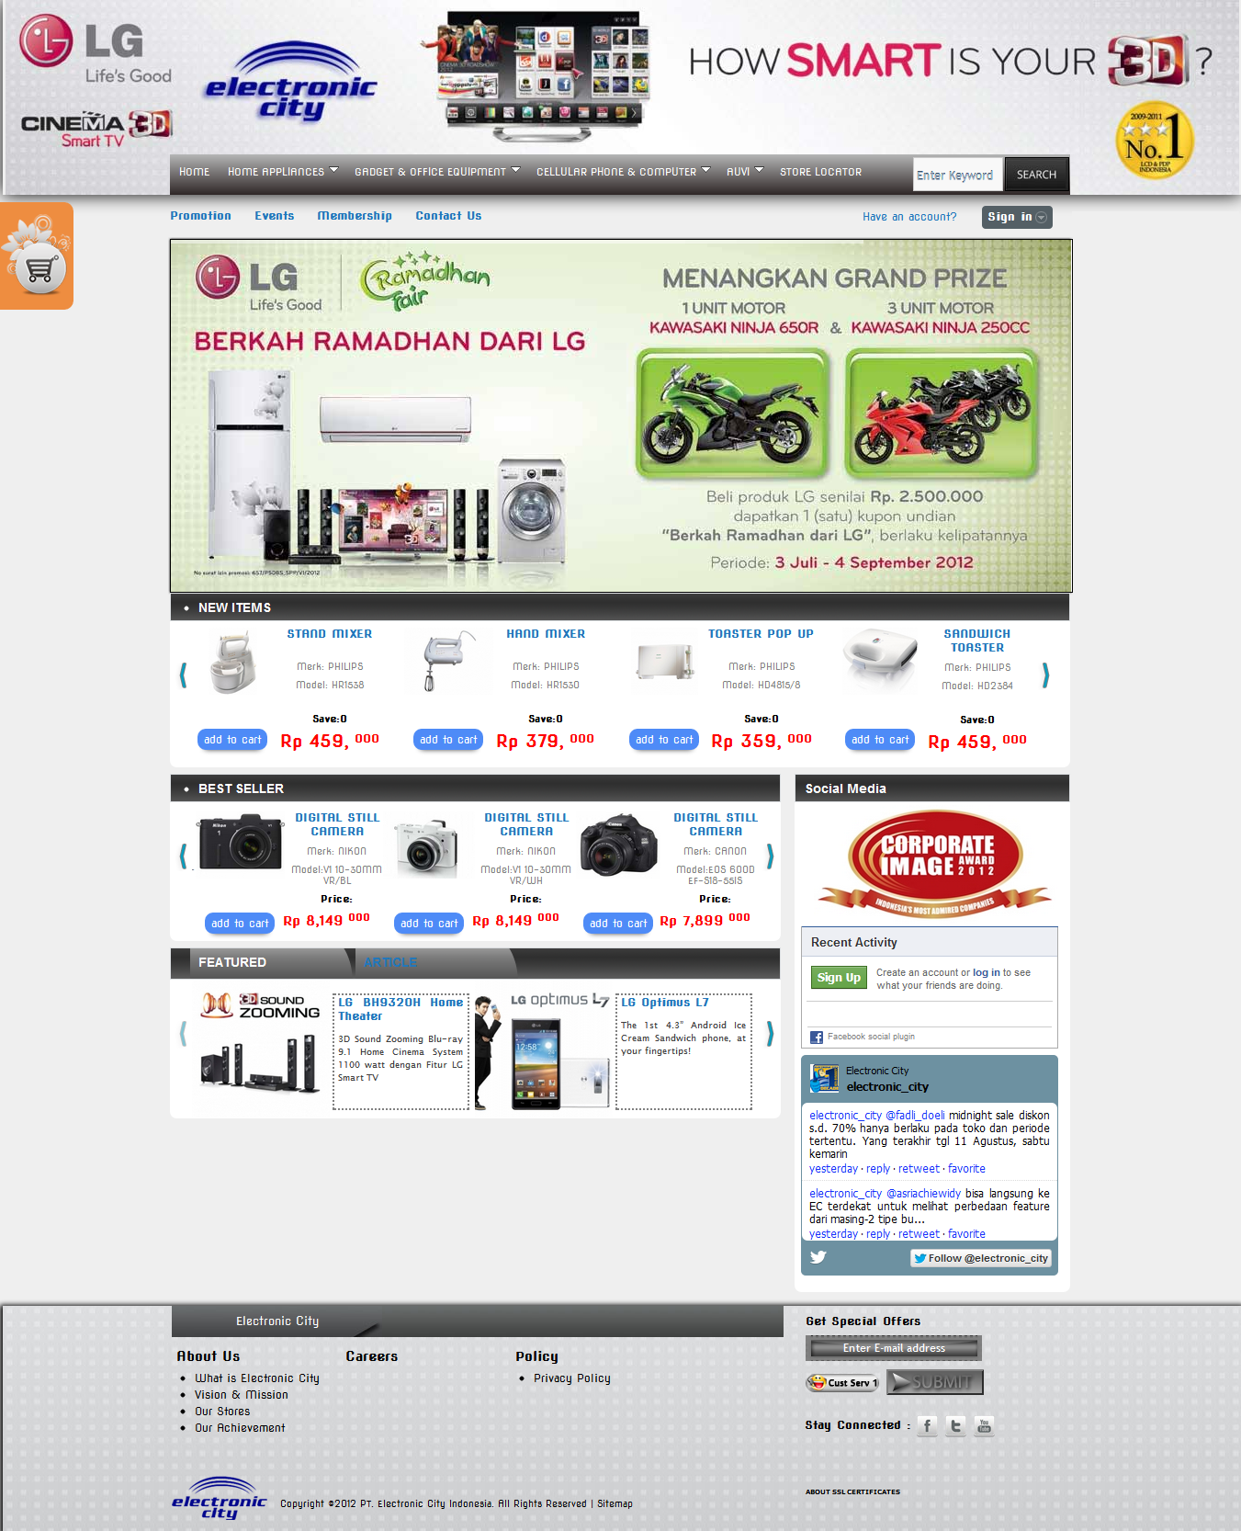
OUR WEBSTORE

Slide 8
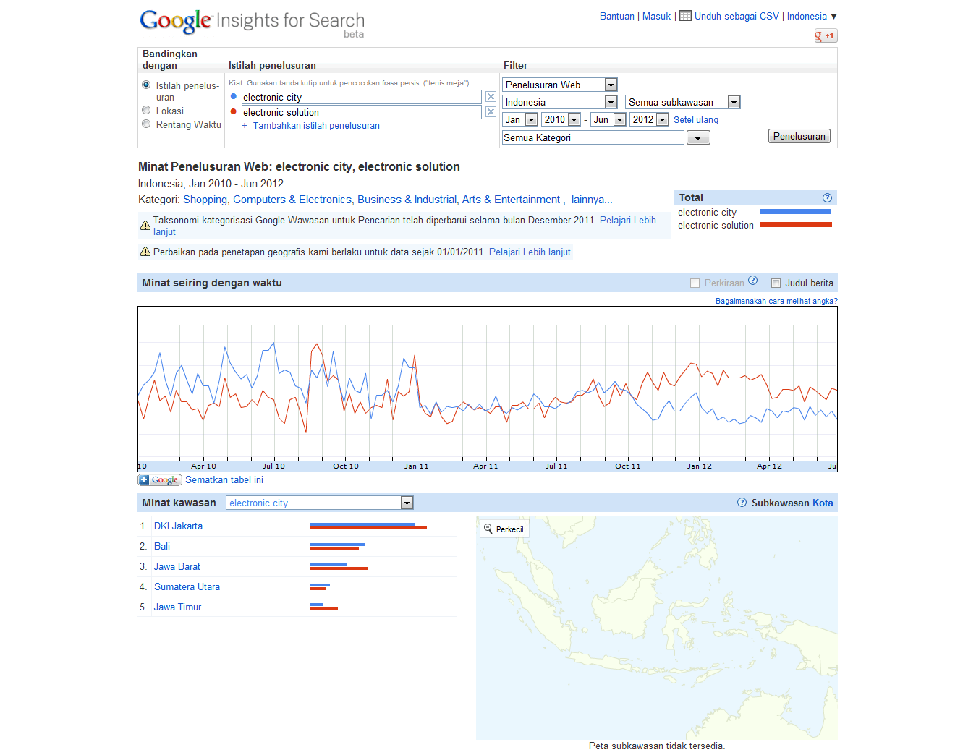
BRANDING (BEFORE)

Slide 9
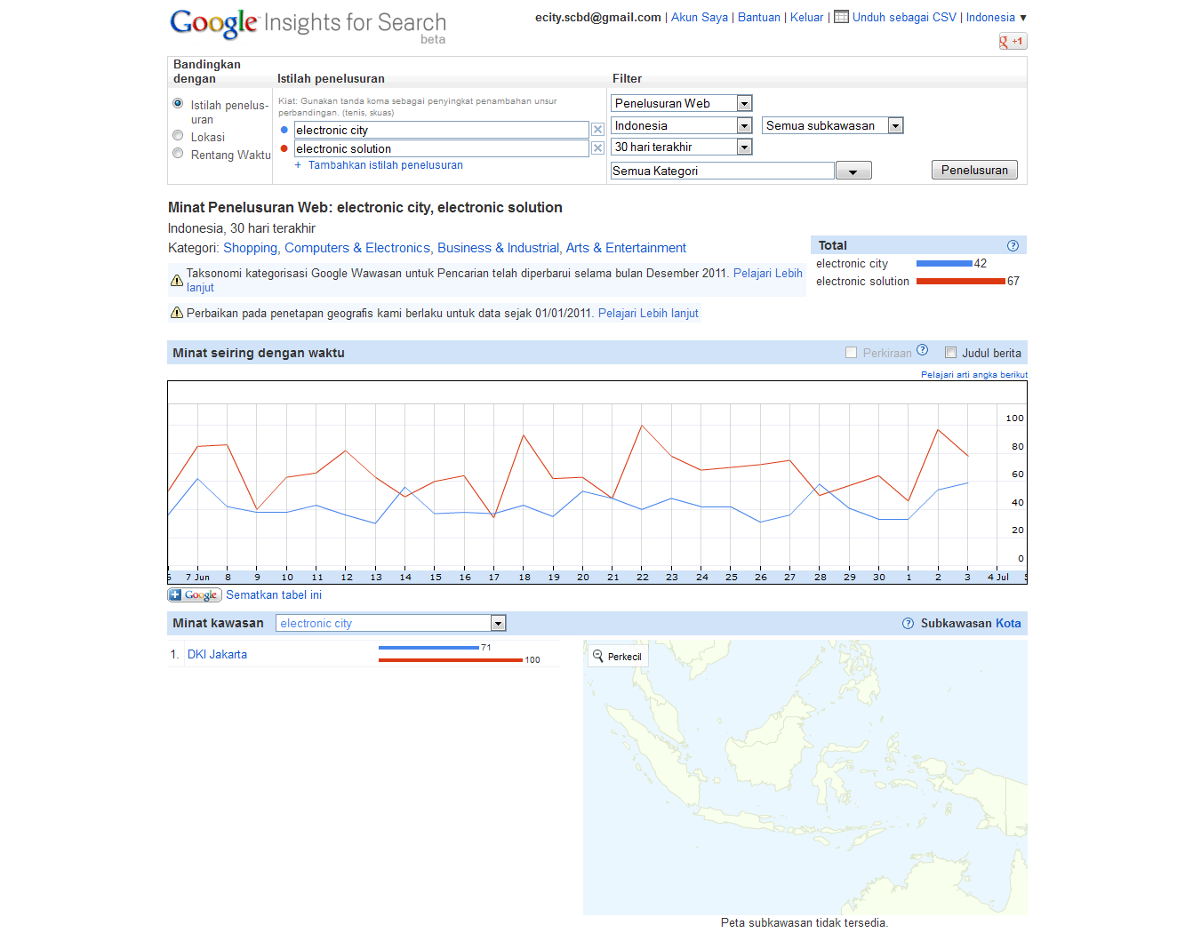
BRANDING (CURRENT)

Slide 10
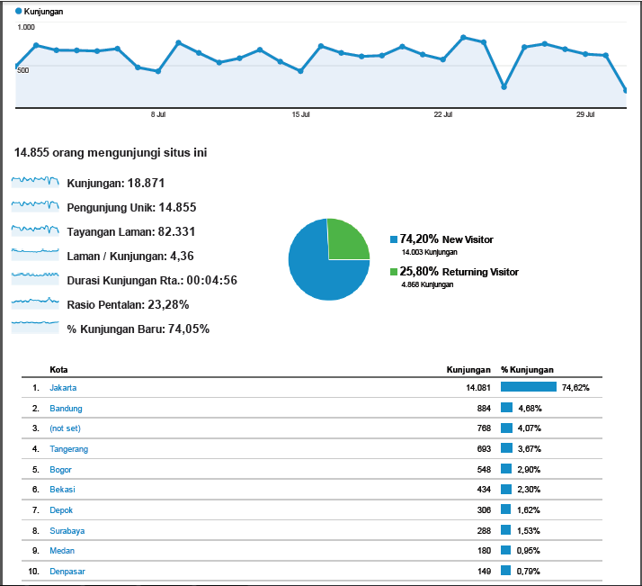
WEB TRAFFIC JULY

Slide 11
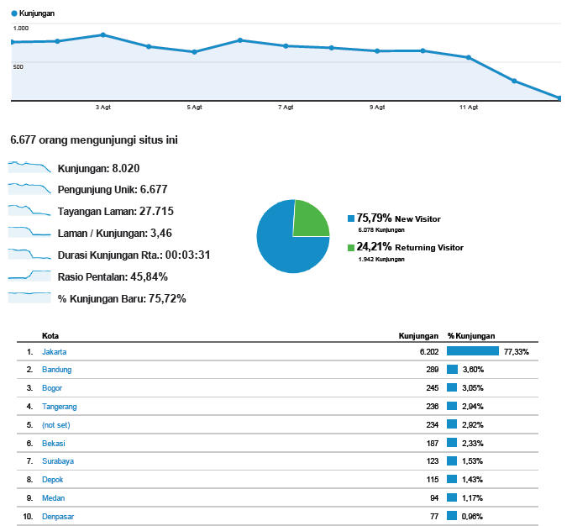
WEB TRAFFIC AUGUST

Slide 12
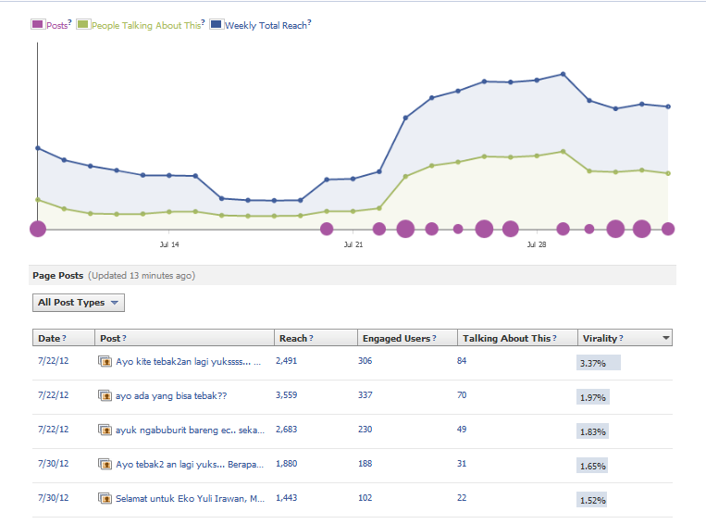
FACEBOOK

Slide 13
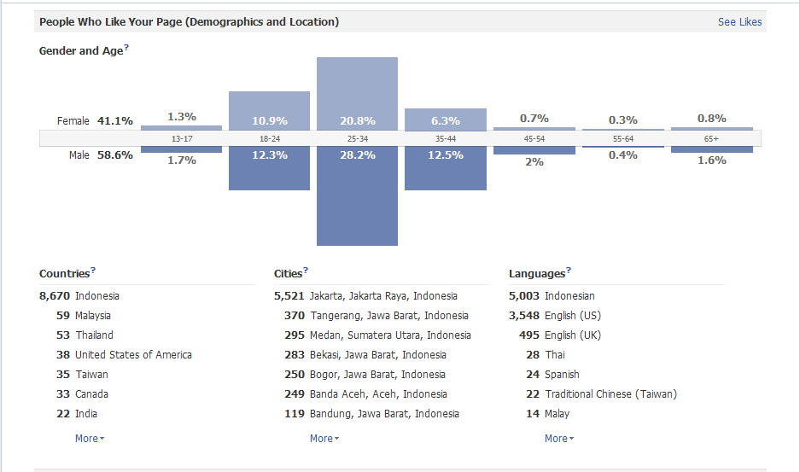
FACEBOOK

Slide 14
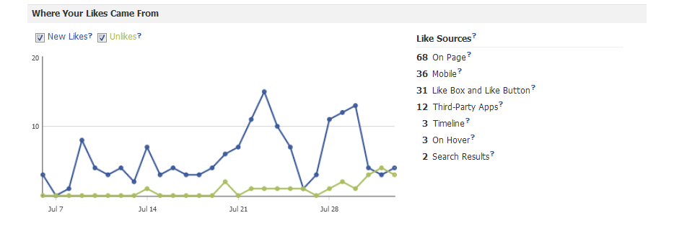
FACEBOOK

Slide 15
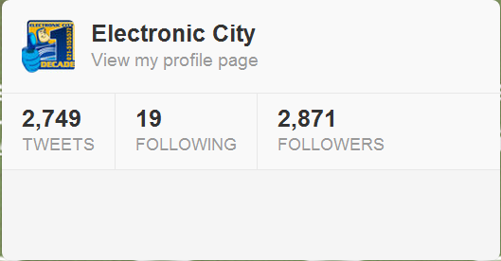
TWITTER

Slide 16
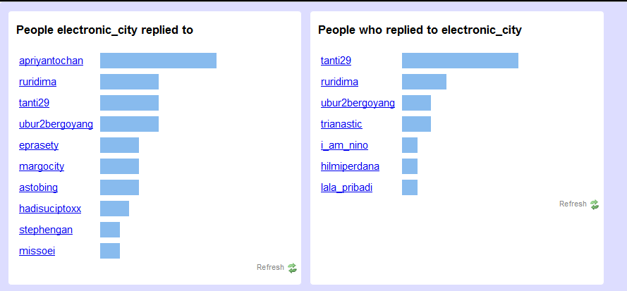
TWITTER

Slide 17
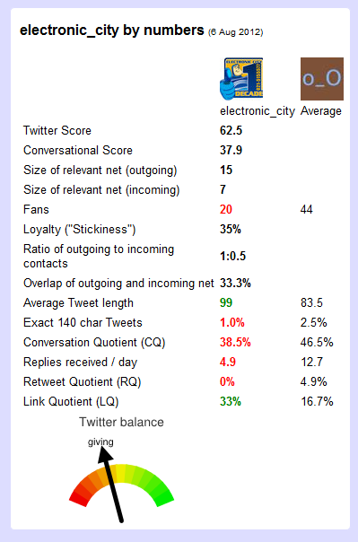
TWITTER

Slide 18
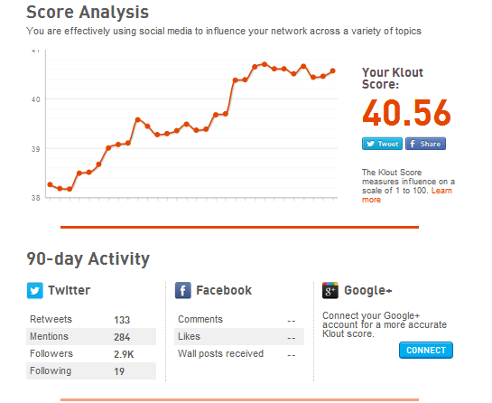
TWITTER

Slide 19
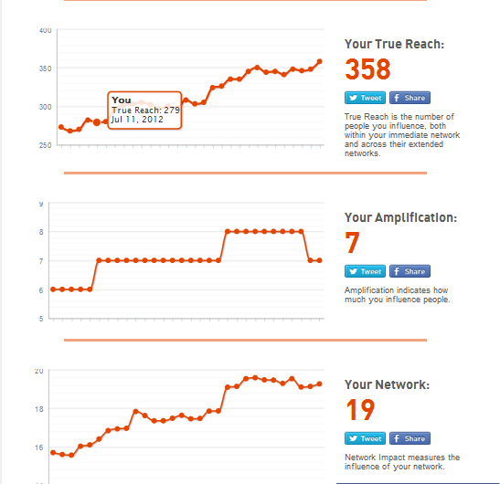
TWITTER

Slide 20
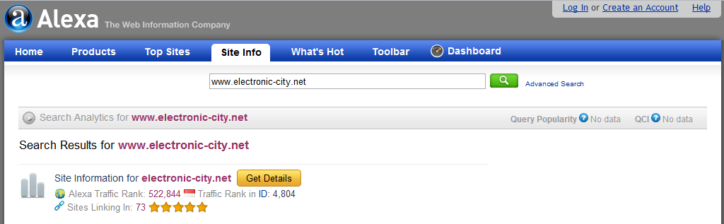
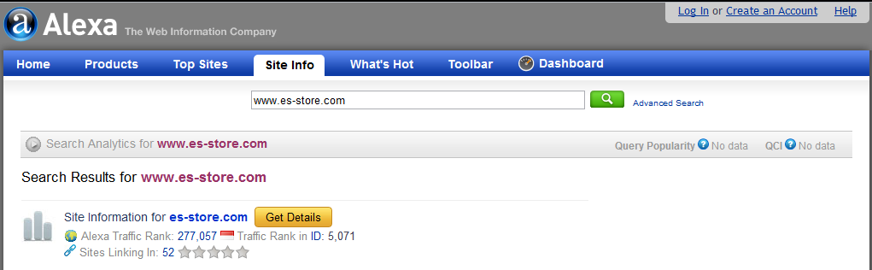
WEBSITE RANK

Slide 21
NEXT STRATEGIES
SOCIAL MEDIA
BUILD COMMUNITY
MAKE IT READY FOR EVENTS
FOCUSING ON REACH PEOPLE
WEBSTORE
MORE ITEMS
MORE DETAILS
FOCUSING ON SEO & TRAFFIC
- COMPLETE INTEGRATION : LOGISTIC & PAYMENT GATEWAY

Slide 22
SOC-MED PLANNING
WEEKS | EVENT | KPI | PRIZES
1 | BLOGGER EVENT | 5000 Followers & 5000 Fans | 3 Category, (Gadget, Auvi, Cameras) & Contract as Reviewer
2 | EVENT WAIT
3 | EVENT WAIT
4 | SURVEY REAL/COMMERCE STORE | 2000 Followers & 2000 Fans | Gadget & Auvi
5 | EVENT WAIT
6 | EVENT WAIT
7 | POINT GAMES | 5000 Followers & 5000 Fans | Gadget & Auvi
8 | EVENT WAIT
9 | EVENT WAIT
10 | HASHTAG EVENT | 2000 Followers & 2000 Fans | Vouchers & Gadget
11 | EVENT WAIT
12 | VIDEO IKLAN EC COMPETITION | 2000 Followers & 2000 Fans | Tablet & Money
13 | EVENT WAIT
14 | EVENT WAIT

Slide 23
SOC-MED DAILY
TOPICS | MON | TUE | WED | THU | FRI | SAT | SUN
TIPS AND TRICKS |  |  | √ |  |  |  | √
HUMOUR |  | √ |  |  | √
CHIT CHAT | √ | √ |  |  | √ | √
NEW TRENDS |  |  | √ |  |  |  | √
MOVIES | √
OLD FACT |  |  |  | √
HEALTH |  |  |  |  |  | √
LIFESTYLE |  |  |  | √
PROMOTION | √ | √ | √ | √ | √ | √ | √

Slide 24
PLANNING TIMELINE
STRATEGY | OCT |  |  |  | NOV |  |  |  | DEC |  |  |  | JAN |  |  |  | FEB |  |  |  | MAR |  |  |  | KETERANGAN
 | 1 | 2 | 3 | 4 | 1 | 2 | 3 | 4 | 1 | 2 | 3 | 4 | 1 | 2 | 3 | 4 | 1 | 2 | 3 | 4 | 1 | 2 | 3 | 4
PAYMENT
PAYMENT GATEWAY (BCA CC) | √ | √ | √ | √ | √ | √ | √ | √ | √ | √ | √ | √ | √ | √ | √ | √ | √ | √ | √ | √ | √ | √ | √ | √ | FINISH
JNE | ? | ? | ? | ? | ? | ? | ? | ? |  |  |  |  |  |  |  |  |  |  |  |  |  |  |  |  | MASIH PROSES PKS
JATIS TRANSFER ROUTING | ? | ? | ? | ? | ? | ? | ? | ? |  |  |  |  |  |  |  |  |  |  |  |  |  |  |  |  | PROSES PENJAJAKAN
KLIKPAY | ? | ? | ? | ? | ? | ? | ? | ? |  |  |  |  |  |  |  |  |  |  |  |  |  |  |  |  | PROSES PENJAJAKAN
KREDIT PLUS/FIF/ADIRA | ? | ? | ? | ? | ? | ? | ? | ? |  |  |  |  |  |  |  |  |  |  |  |  |  |  |  |  | PROSES PENJAJAKAN
BLOG
AUVI |  |  |  |  |  |  |  |  |  |  |  |  |  |  |  |  |  |  |  |  |  |  |  |  | PEMBUATAN BLOG DIMULAI
GADGET |  |  |  |  |  |  |  |  |  |  |  |  |  |  |  |  |  |  |  |  |  |  |  |  | SETELAH EVENT
CAMERA |  |  |  |  |  |  |  |  |  |  |  |  |  |  |  |  |  |  |  |  |  |  |  |  | BLOGGER SELESAI
FORUM
FORUM INTEGRATION |  |  |  |  |  |  |  |  |  |  |  |  |  |  |  |  |  |  |  |  |  |  |  |  | UNTUK KOMUNITAS, COMPLAIN
BRANDING
FORUM (KASKUS) |  |  |  |  |  |  |  |  |  |  |  |  |  |  |  |  |  |  |  |  |  |  |  |  | BRANDING LEWAT FORUM
DISDUS |  |  |  |  |  |  |  |  |  |  |  |  |  |  |  |  |  |  |  |  |  |  |  |  | EVOUCHER (REJECTED CAUSE OF PRICE)
KATALOG PROMO |  |  |  |  |  |  |  |  |  |  |  |  |  |  |  |  |  |  |  |  |  |  |  |  | PROMO KATALOG
MOBILE APPS
iOS & ANDROID |  |  |  |  |  |  |  |  |  |  |  |  |  |  |  |  |  |  |  |  |  |  |  |  | APPLE IPAD, IPHONE, ANDROID PHONE
BLACKBERRY |  |  |  |  |  |  |  |  |  |  |  |  |  |  |  |  |  |  |  |  |  |  |  |  | -

Slide 25
E-COMMERCE MARKET
SURVEYS AND MARKET DEMANDS

Slide 26
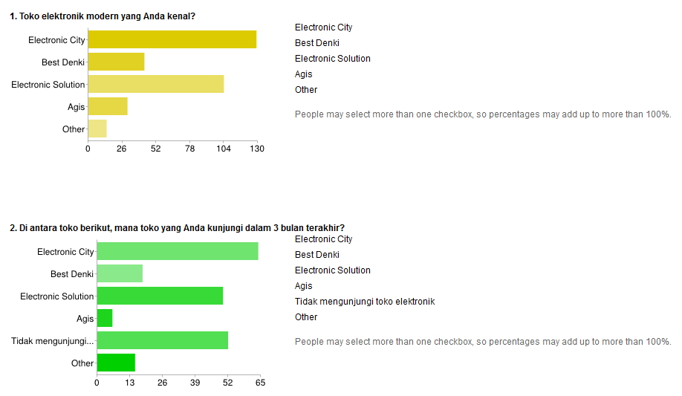
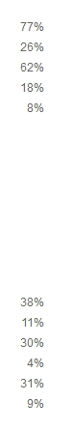
Our Market

Slide 27
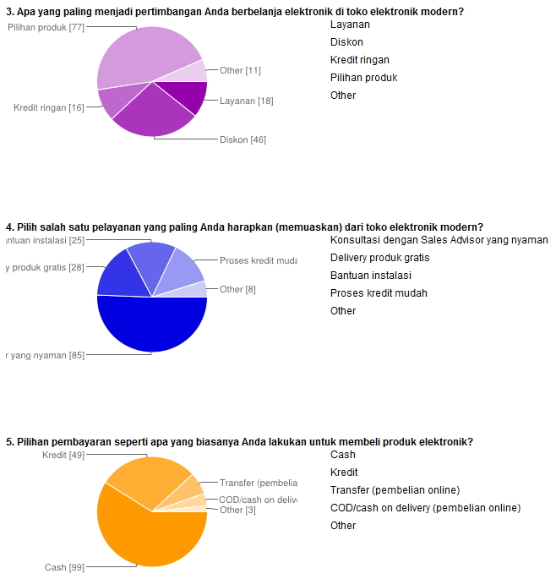
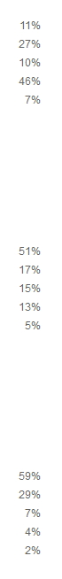
Our Market

Slide 28
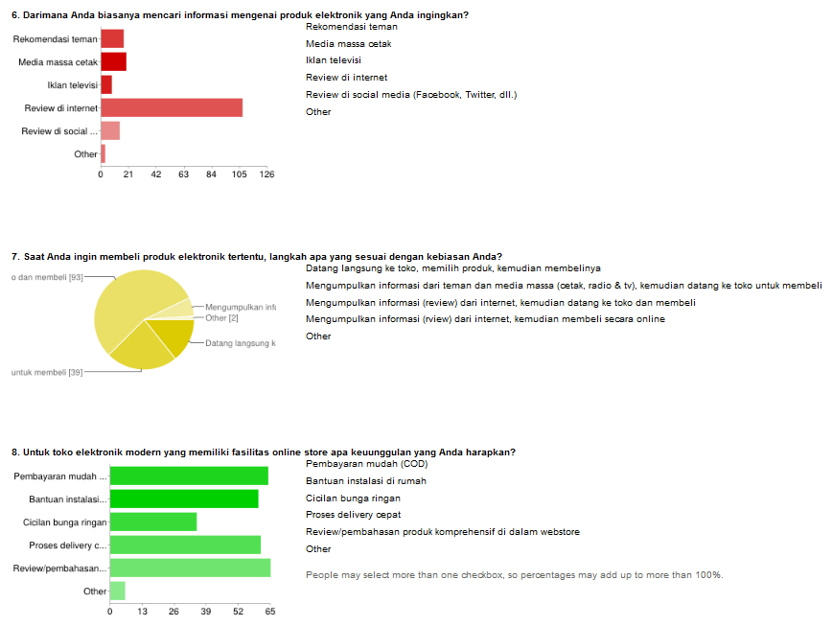
Our Market

Slide 29







SOCIAL MEDIA

Slide 30
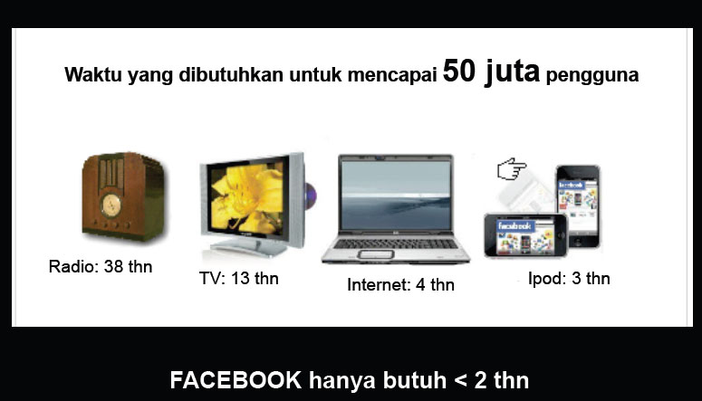
SOCIAL MEDIA

Slide 31
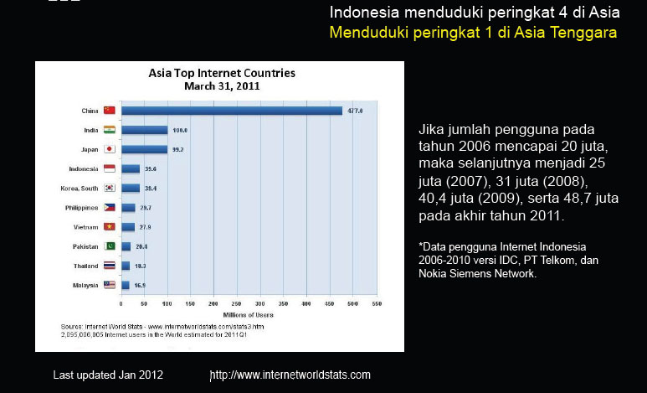
SOCIAL MEDIA

Slide 32
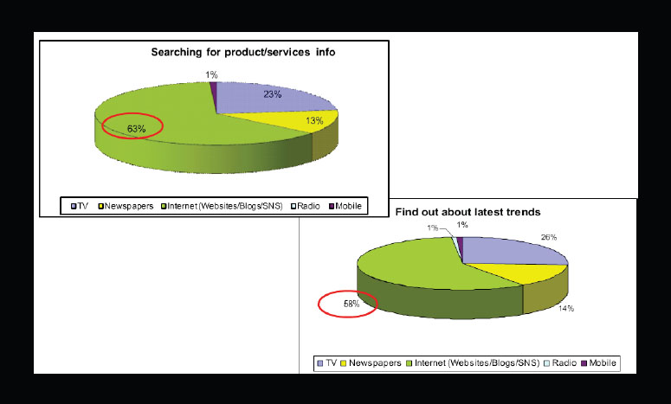
SOCIAL MEDIA

Slide 33

FACEBOOK
Social Media

Slide 34
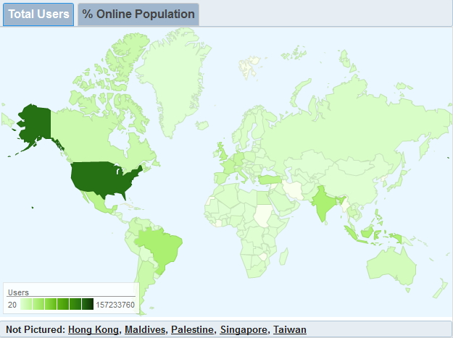
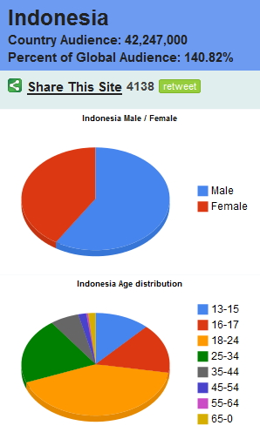
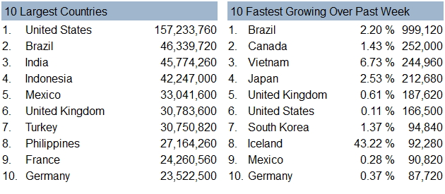
SOCIAL MEDIA

Slide 35
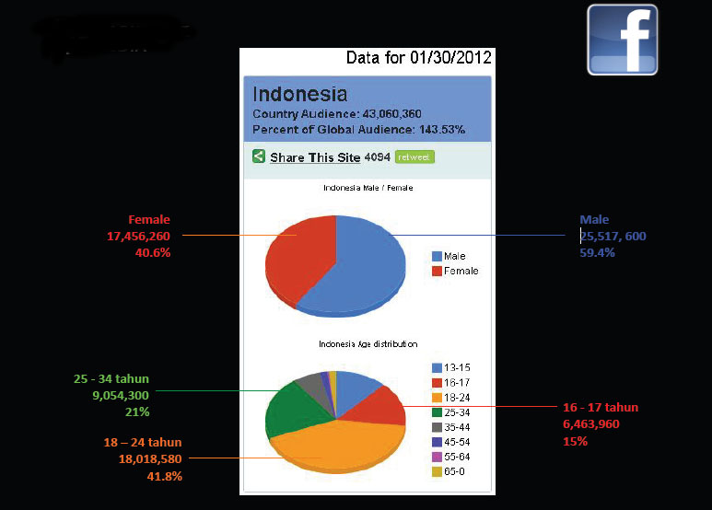
SOCIAL MEDIA

Slide 36
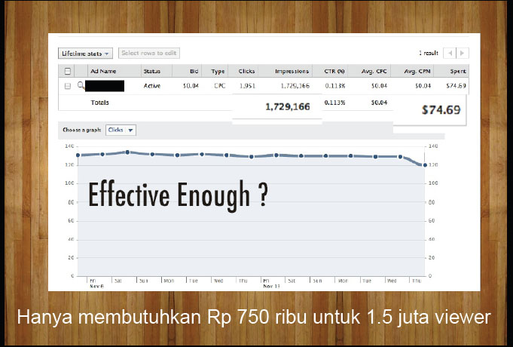
SOCIAL MEDIA

Slide 37
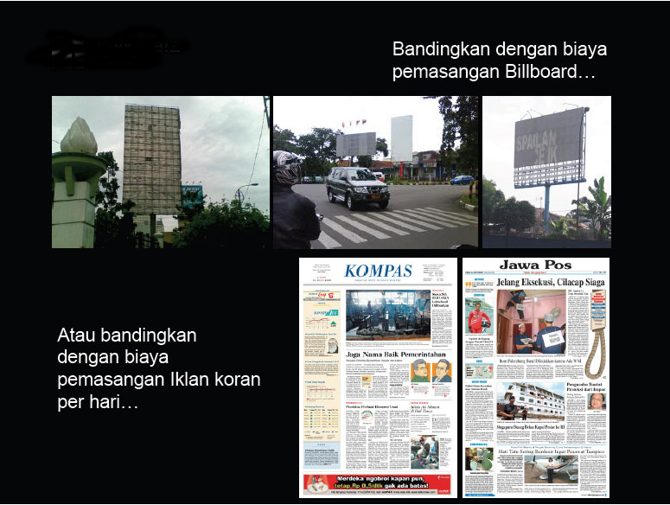
SOCIAL MEDIA

Slide 38

TWITTER
SOCIAL MEDIA

Slide 39
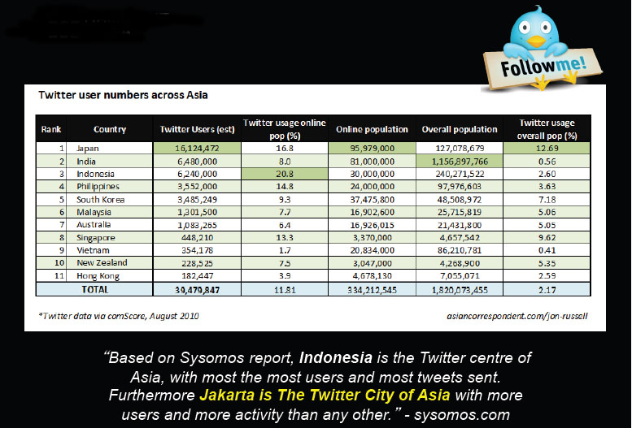
SOCIAL MEDIA

Slide 40
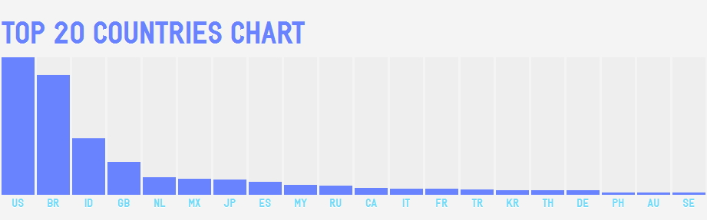
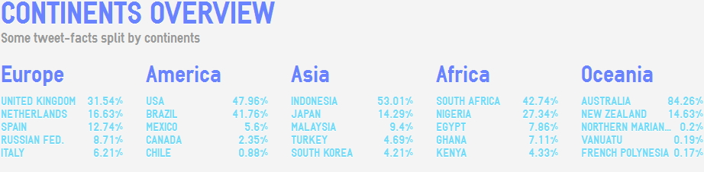

SOCIAL MEDIA

Slide 41
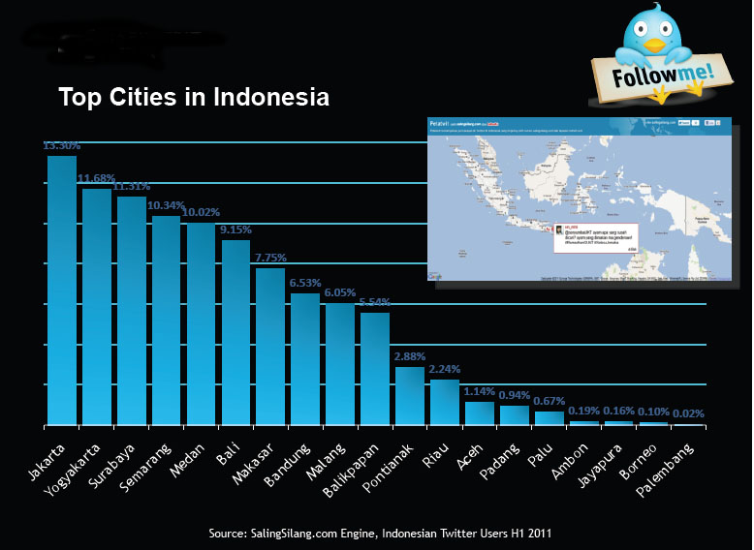
SOCIAL MEDIA

Slide 42
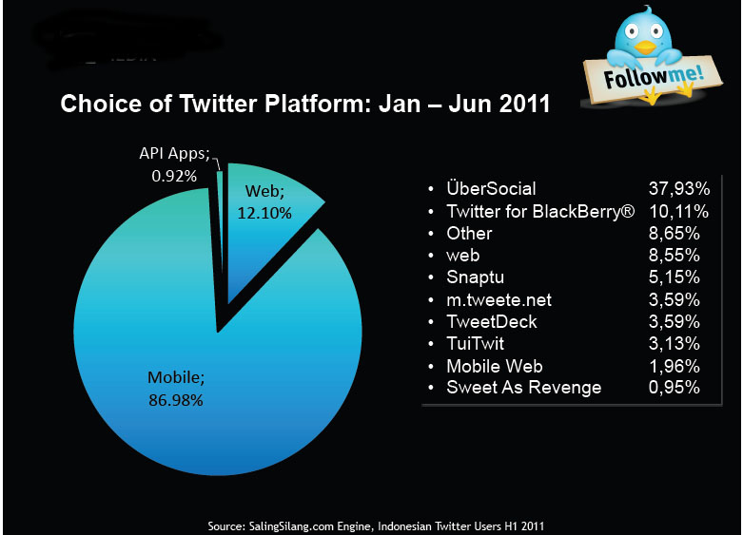
SOCIAL MEDIA

Slide 43
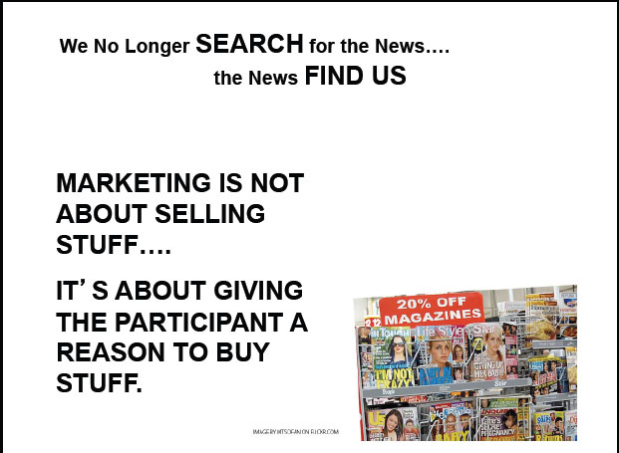
SOCIAL MEDIA

Slide 44

YOUTUBE
VISUAL MARKETING

Slide 45
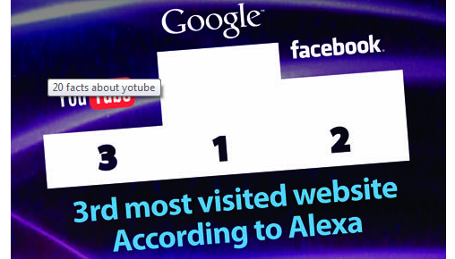

Slide 46
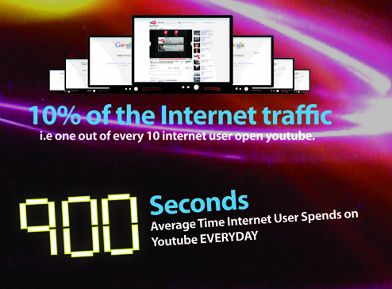

Slide 47
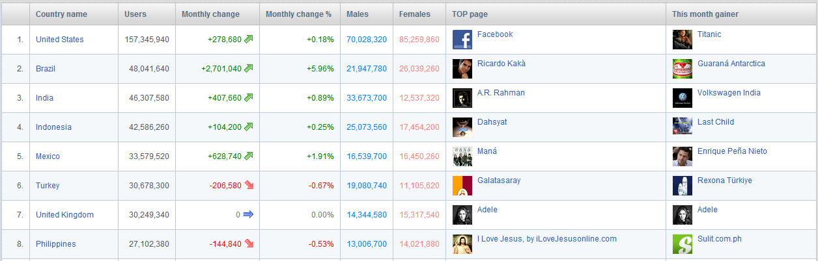

Slide 48

YOUTUBE ONLY
VIDEO SHARING

Slide 49
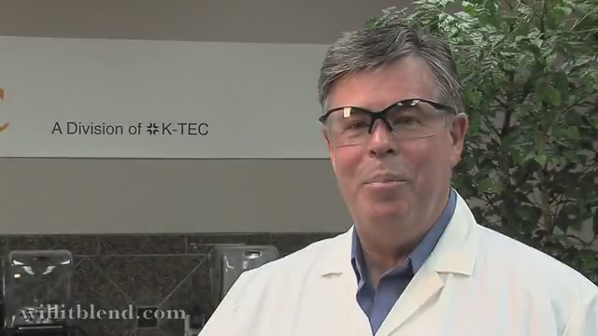
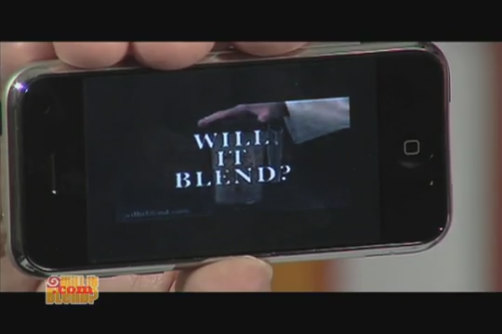
VISUAL MARKETING
EXAMPLE
OVER 160 MILLION VIEWER,
CAN YOU FIGURE IF
THE CONVERSION RATE IS 0.1%
HOW MUCH HE MAKES?

Slide 50

Youtube ES ads for es-Store.com

Slide 51

SOCIAL MEDIA

Slide 52
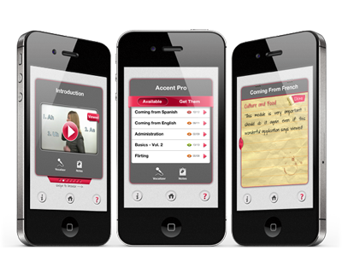
MOBILE APPS
iOS, Android, Blackberry

Slide 53
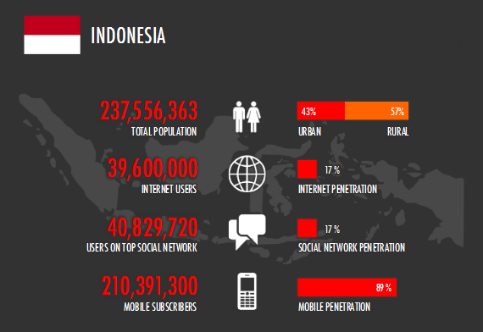
MOBILE APPS

Slide 54
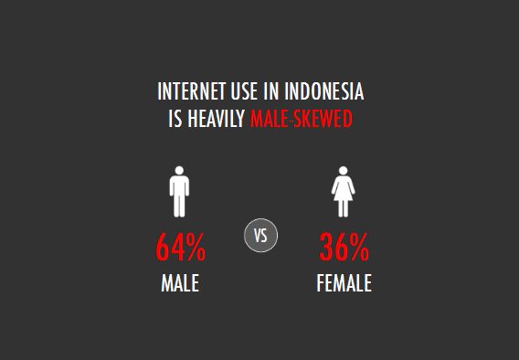
MOBILE APPS

Slide 55
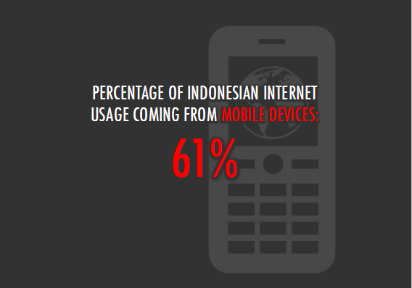
MOBILE APPS

Slide 56
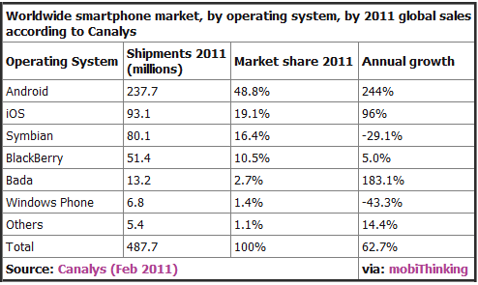
MOBILE APPS

Slide 57
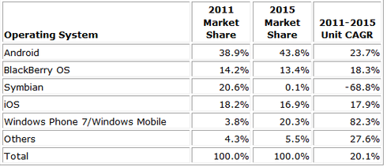
MOBILE APPS

Slide 58
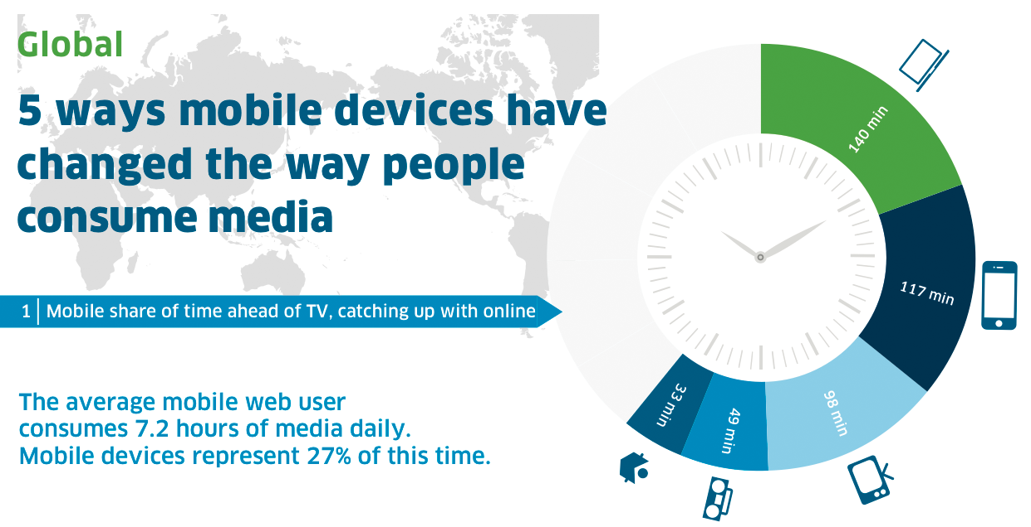
MOBILE APPS

Slide 59
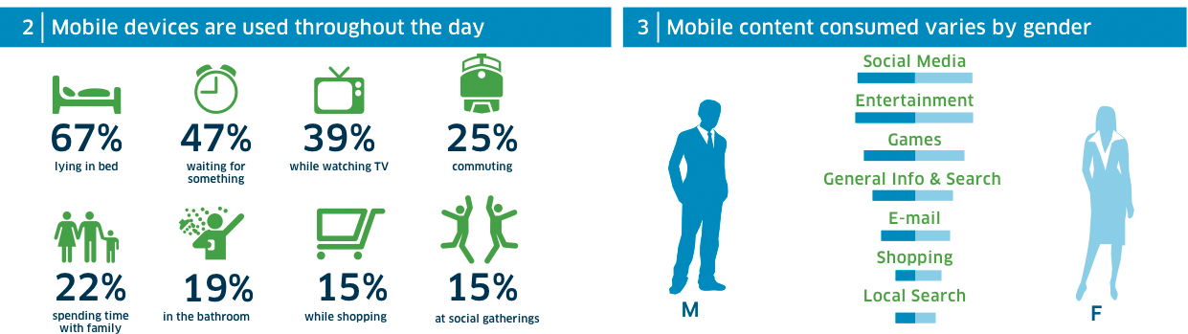
MOBILE APPS

Slide 60

MOBILE APPS

Slide 61

MOBILE APPS

Slide 62
ECOMMERCE PRESENTATION
THANK YOU
AUG-2012

